Slide 1


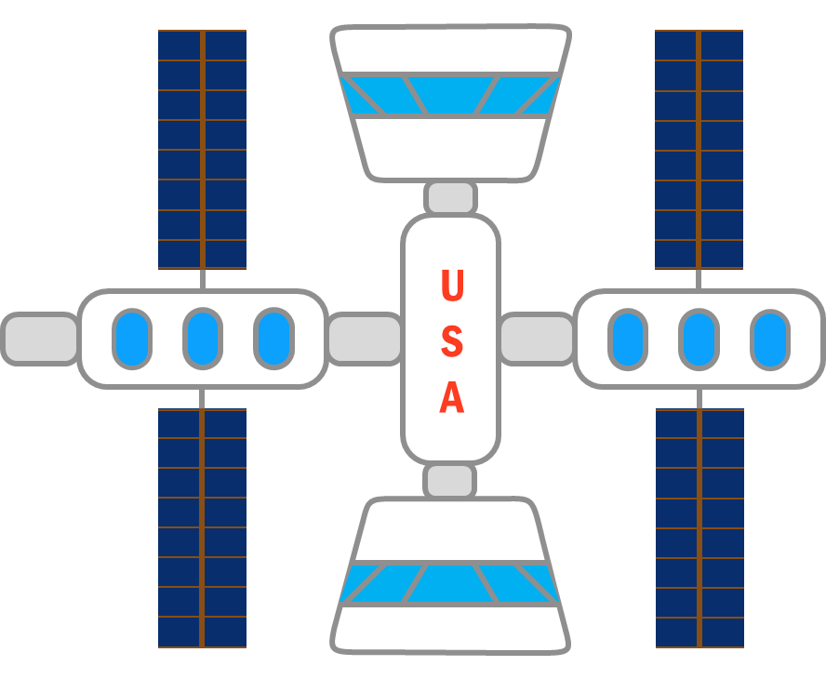
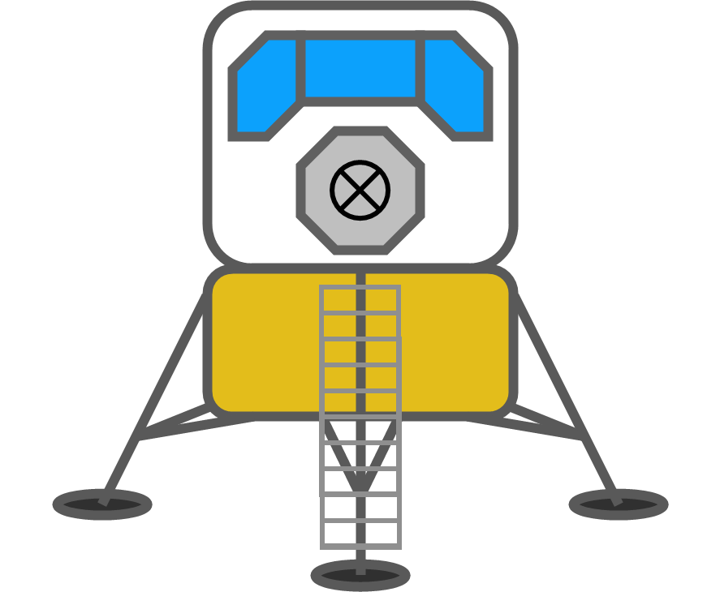
Reusable Shock Absorber
for New Lunar Lander
Virtual Design Review 2
Team 515
December 1, 2020
1

Slide 2






Team Members
Team Members
Josh Blank
Design Engineer
Matt Fowler
Systems Engineer
Tristan Jenkins
Design Engineer
Alex Noll
Mechanical Engineer
Melanie Porter
Dynamics Engineer
Tristan Jenkins
2

Slide 3
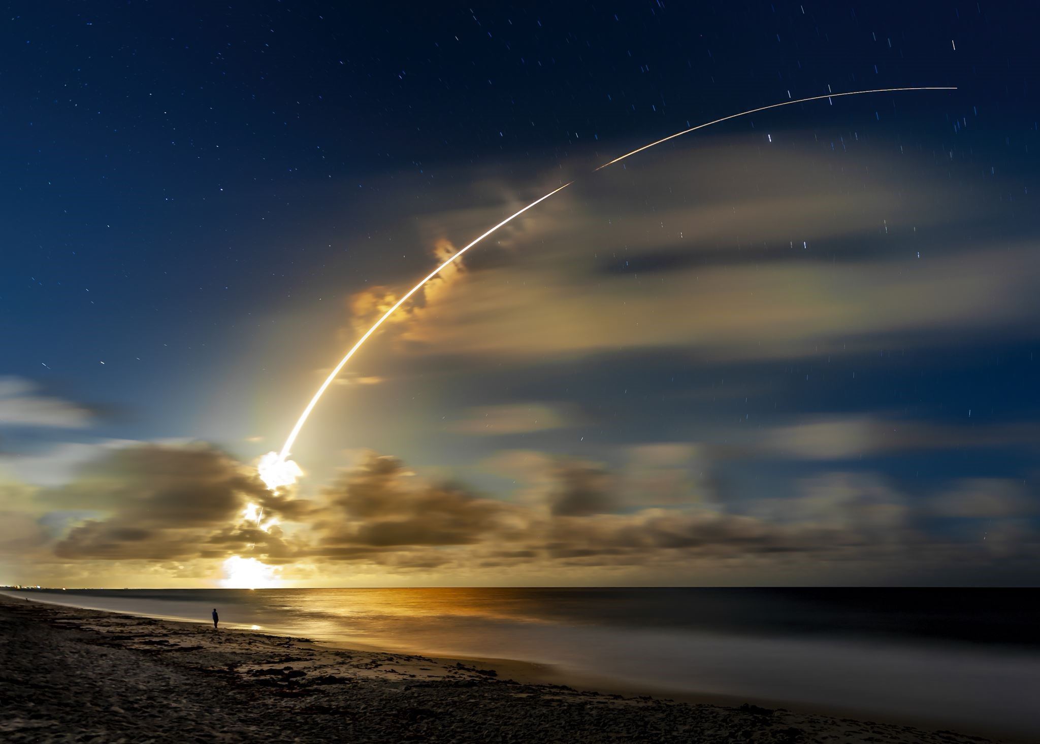

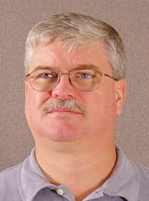



Sponsor & Advisor
Sponsor & Advisor
Project Sponsor
Rachel McCauley
MSFC Advanced Concepts Deputy Manager at NASA
Academic Advisor
Keith Larson
Teaching Faculty I
Tristan Jenkins

Slide 4


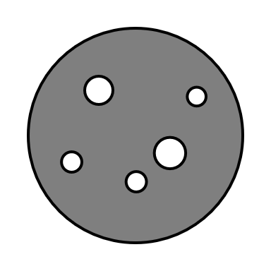
Objective
To design a reusable device for the human lander system that will dissipate the impact energy in such a way that it does not damage the vessel or occupants.
Tristan Jenkins

Slide 5
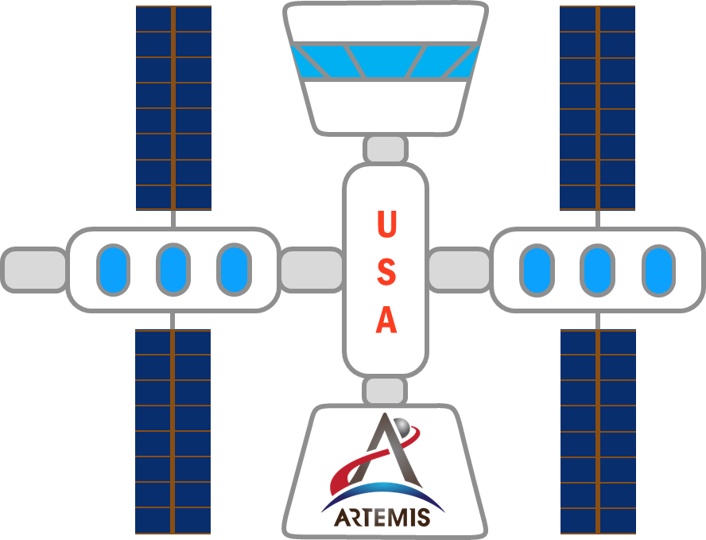

Project Description
Project Description
Tristan Jenkins

Slide 6
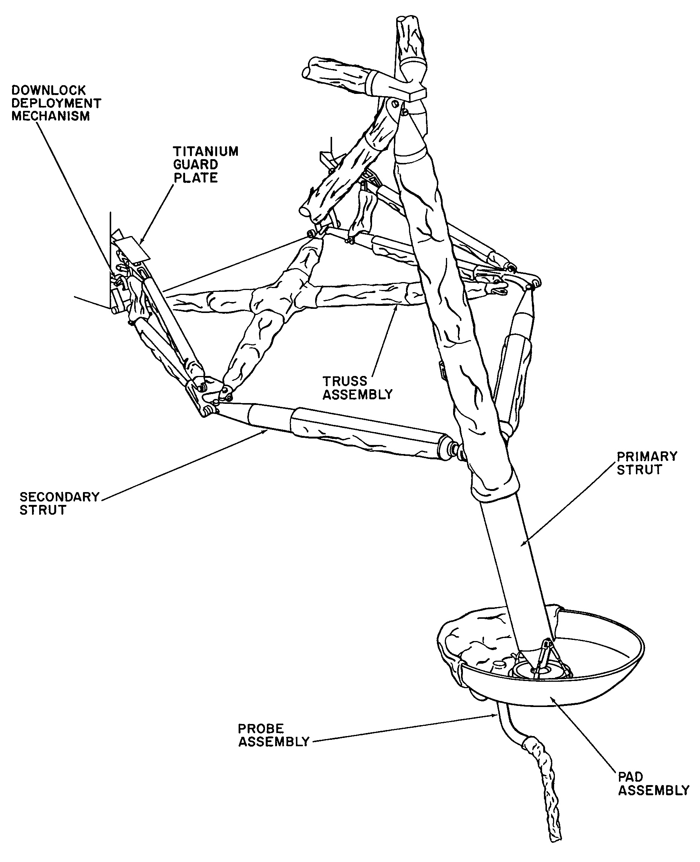
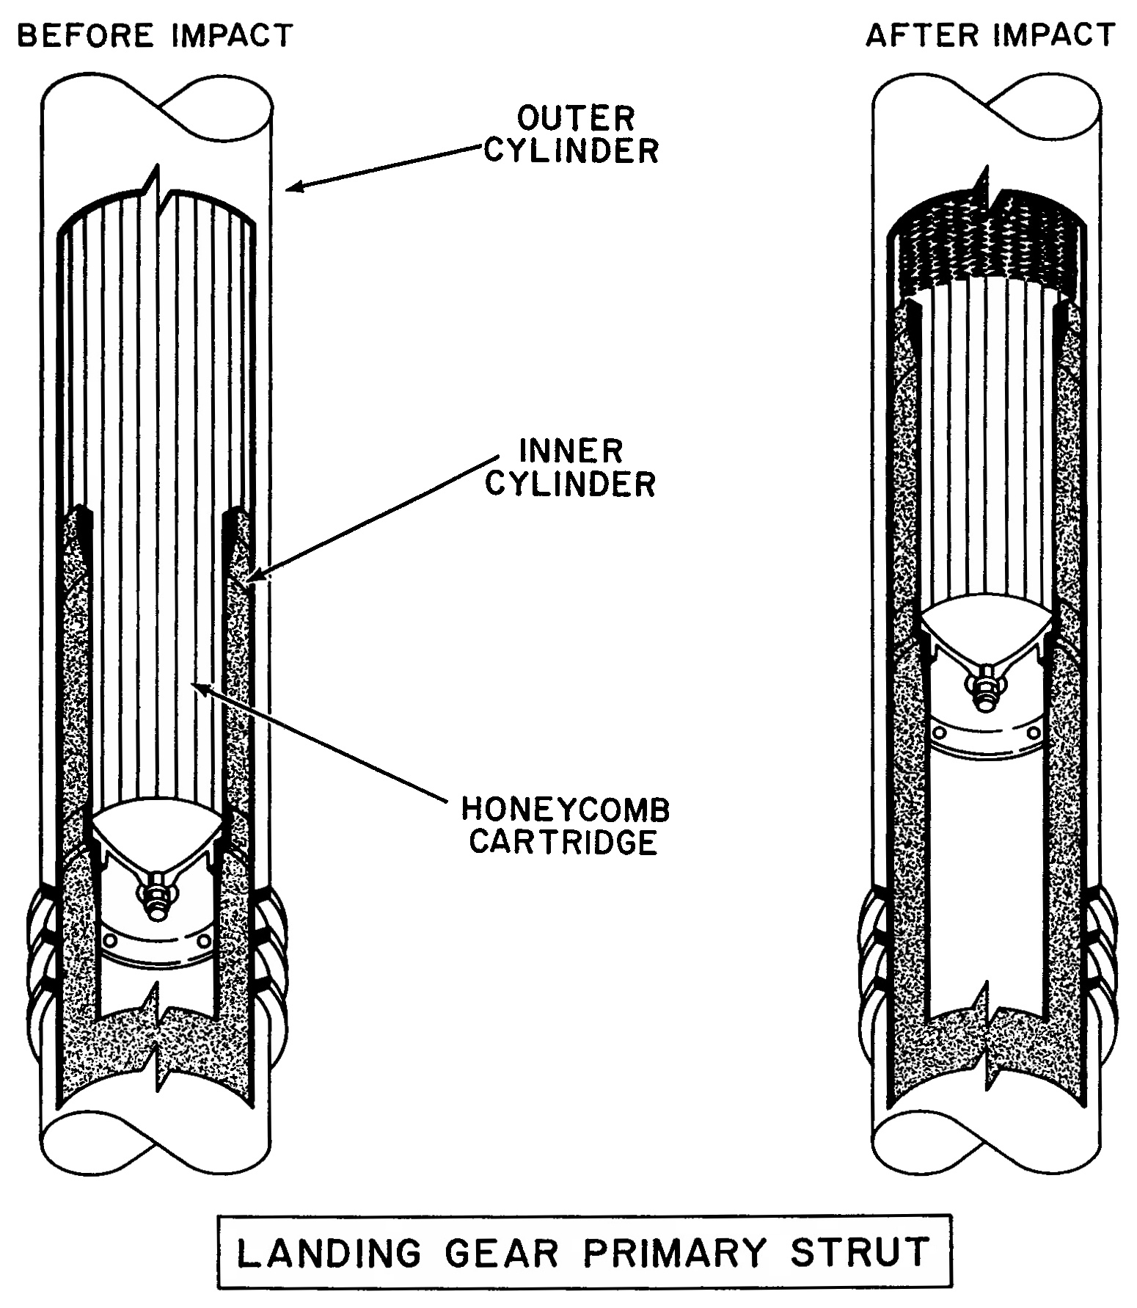
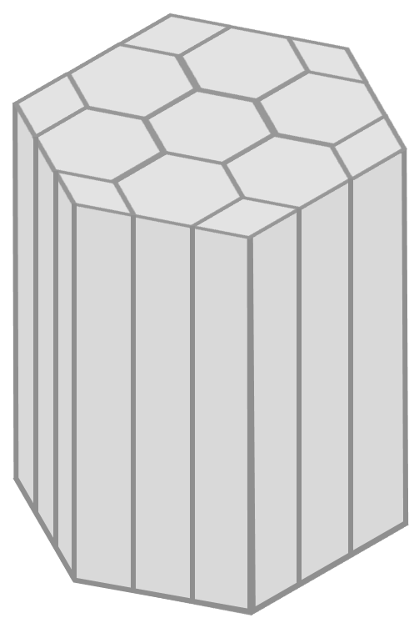
Apollo Shock Absorber
Apollo Shock Absorber
LANDING GEAR ASSEMBLY
[1]
ALUMINUM HONEYCOMB VISUAL AID
LANDING GEAR PRIMARY STRUT
[1]
Tristan Jenkins

Slide 7
Functions
Functions
Shock Absorber
Support
Impact Reduction
Reusability
Absorb Shock
Support Mass
Absorb Impact Energy
Returns to original state
Dampen Vibrations
Transform Energy
Indicate Reusability
Link
Prevent Excessive Rebound
Dissipate Energy
Store Energy
Tristan Jenkins

Slide 8

Metric
Functions
Targets
Absorb Impact Energy
~145 kJ
Absorb Structural Shock
3 g’s
Support Mass
~25,000 kg
Through dissipation of stored energy and/or active reversion, the system returns exactly to original parameters within the time limit.
Materials and geometry of the structure statically supports the mass under Earth and Moon gravity without plastic deformation.
Sensors monitor parameter values over time including when parameters return to initial values.
System remains elastically ductile when subjected to up to 3 g's of acceleration.
All kinetic energy from impact is absorbed into the system as it brings the structure to rest.
Return to Original State
≤ 10 hours
Indicate Reusability
Proves 100% Reusability
Prevent Excessive Rebound
Rebound < 0.5 m
Transform Energy
KE_{final} = 0
Dampen Vibrations
Settling time < 2 s
Dissipate Energy
≤ 10 hours
Store Energy
~145 kJ
Withstand Lunar Conditions
Lifespan of 10 years
Melanie Porter

Slide 9


Concept Generation
Top Concepts
1
Scissor Jack
2
Leaf Springs
3
Electromagnetic Core
4
Spring Mounted Weights
5
Compliant Mesh
6
Spider Legs
7
Locking Spring
8
Inverted Tripod
Melanie Porter

Slide 10
Selection Process
House of Quality
Pugh Charts
Defines the relationship between customer needs and engineering characteristics.
Used to determine the important qualities for the Pugh Chart.
Compares multiple concepts at once.
Used Apollo 11 shock absorber as datum and eliminated concepts.
Picked a new datum for second Pugh chart
Melanie Porter
Notes:
Before we get into the details of each concept, let’s explain how our selection process worked. We first performed a house of quality to help us understand the relation between customer needs and engineering characteristics. We then used the outcome from the house of quality to set up our Pugh chart. For our first Pugh chart we compared our top 8 ideas to the Apollo class shock absorber. We then pulled out our top 3 ideas and a new datum to compare in our second Pugh chart.

Slide 11
Selection Process
Top Concepts
1
Scissor Jack
2
Leaf Springs
3
Electromagnetic Core
4
Spring Mounted Weights
5
Compliant Mesh
D
6
Spider Legs
7
Locking Spring
8
Inverted Tripod
Melanie Porter

Slide 12
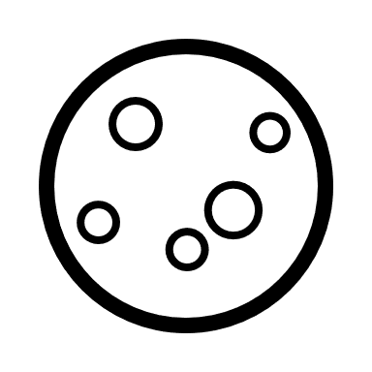

Concept Generation
Rotary Friction Dampers
Positioning Springs
Spider Legs
Team 515
Con
Concept #6
Page 1/4
Josh Blank

Slide 13
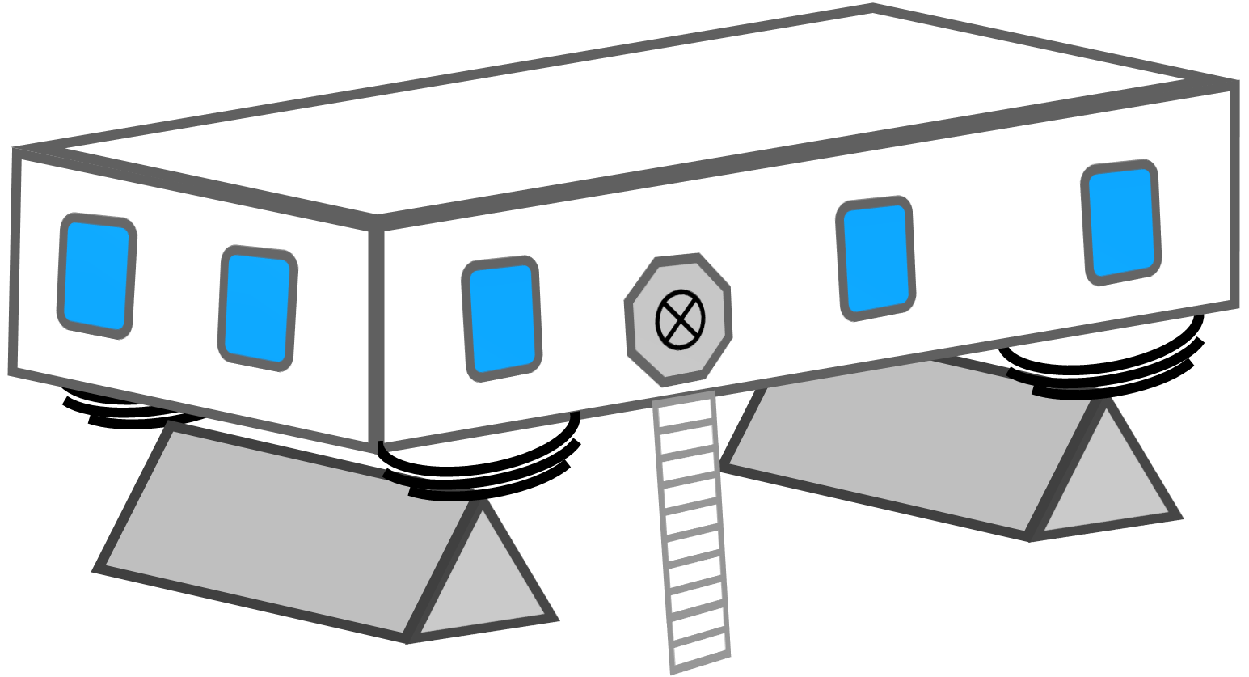
Concept Generation
Leaf Springs
Leaf Springs
Team 515
Con
Footpad ‘axle’
Concept #2
Page 2/4
Josh Blank

Slide 14

Concept Generation
Weighted Springs
Team 515
Con
Concept #4
Page 3/4
Josh Blank

Slide 15
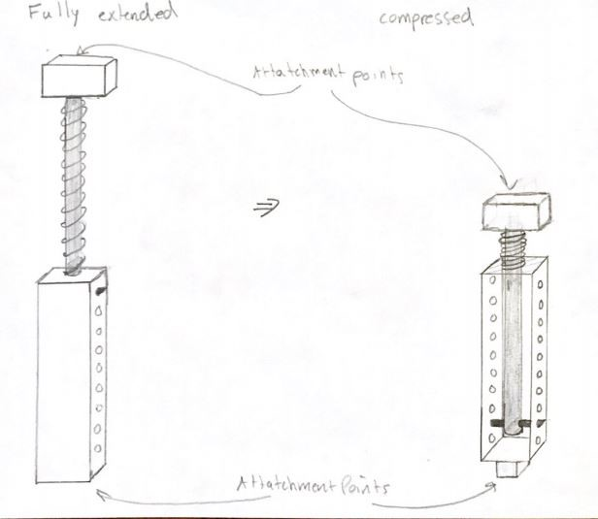


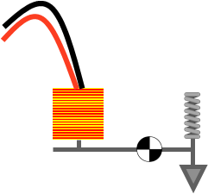
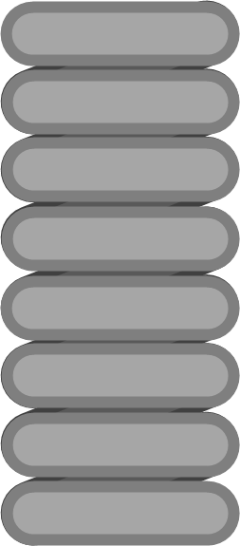
Concept Generation
Compressed
Extended
Ratchet
Solenoid
Locking Springs
Team 515
Con
Spring Pawl
Concept #7
Page 4/4
Josh Blank

Slide 16

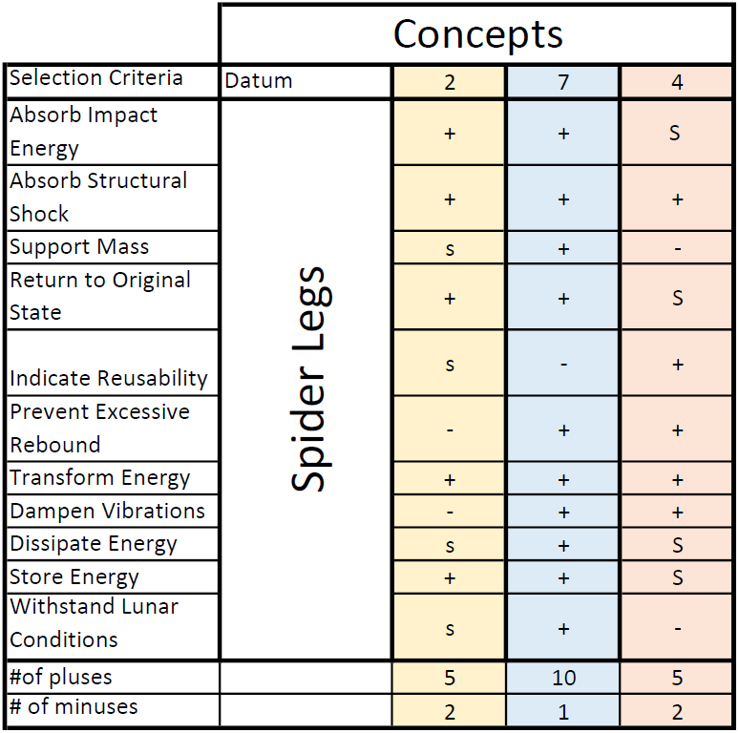
Concept Selection
Top Concepts
2
Leaf Springs
4
Spring Mounted Weights
✓
Locking Spring
7
Josh Blank

Slide 17

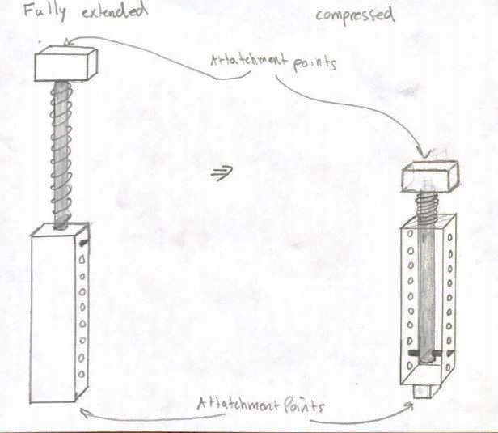


Concept Selection
Locked Spring Design
Temperature variations have little impact.
Effectively absorbs energy and precludes vibrations.
Recycles impact energy
Josh Blank

Slide 18






Looking Forward
Locking Mechanism
3D Drawings
Testing Methods
Josh Blank

Slide 19
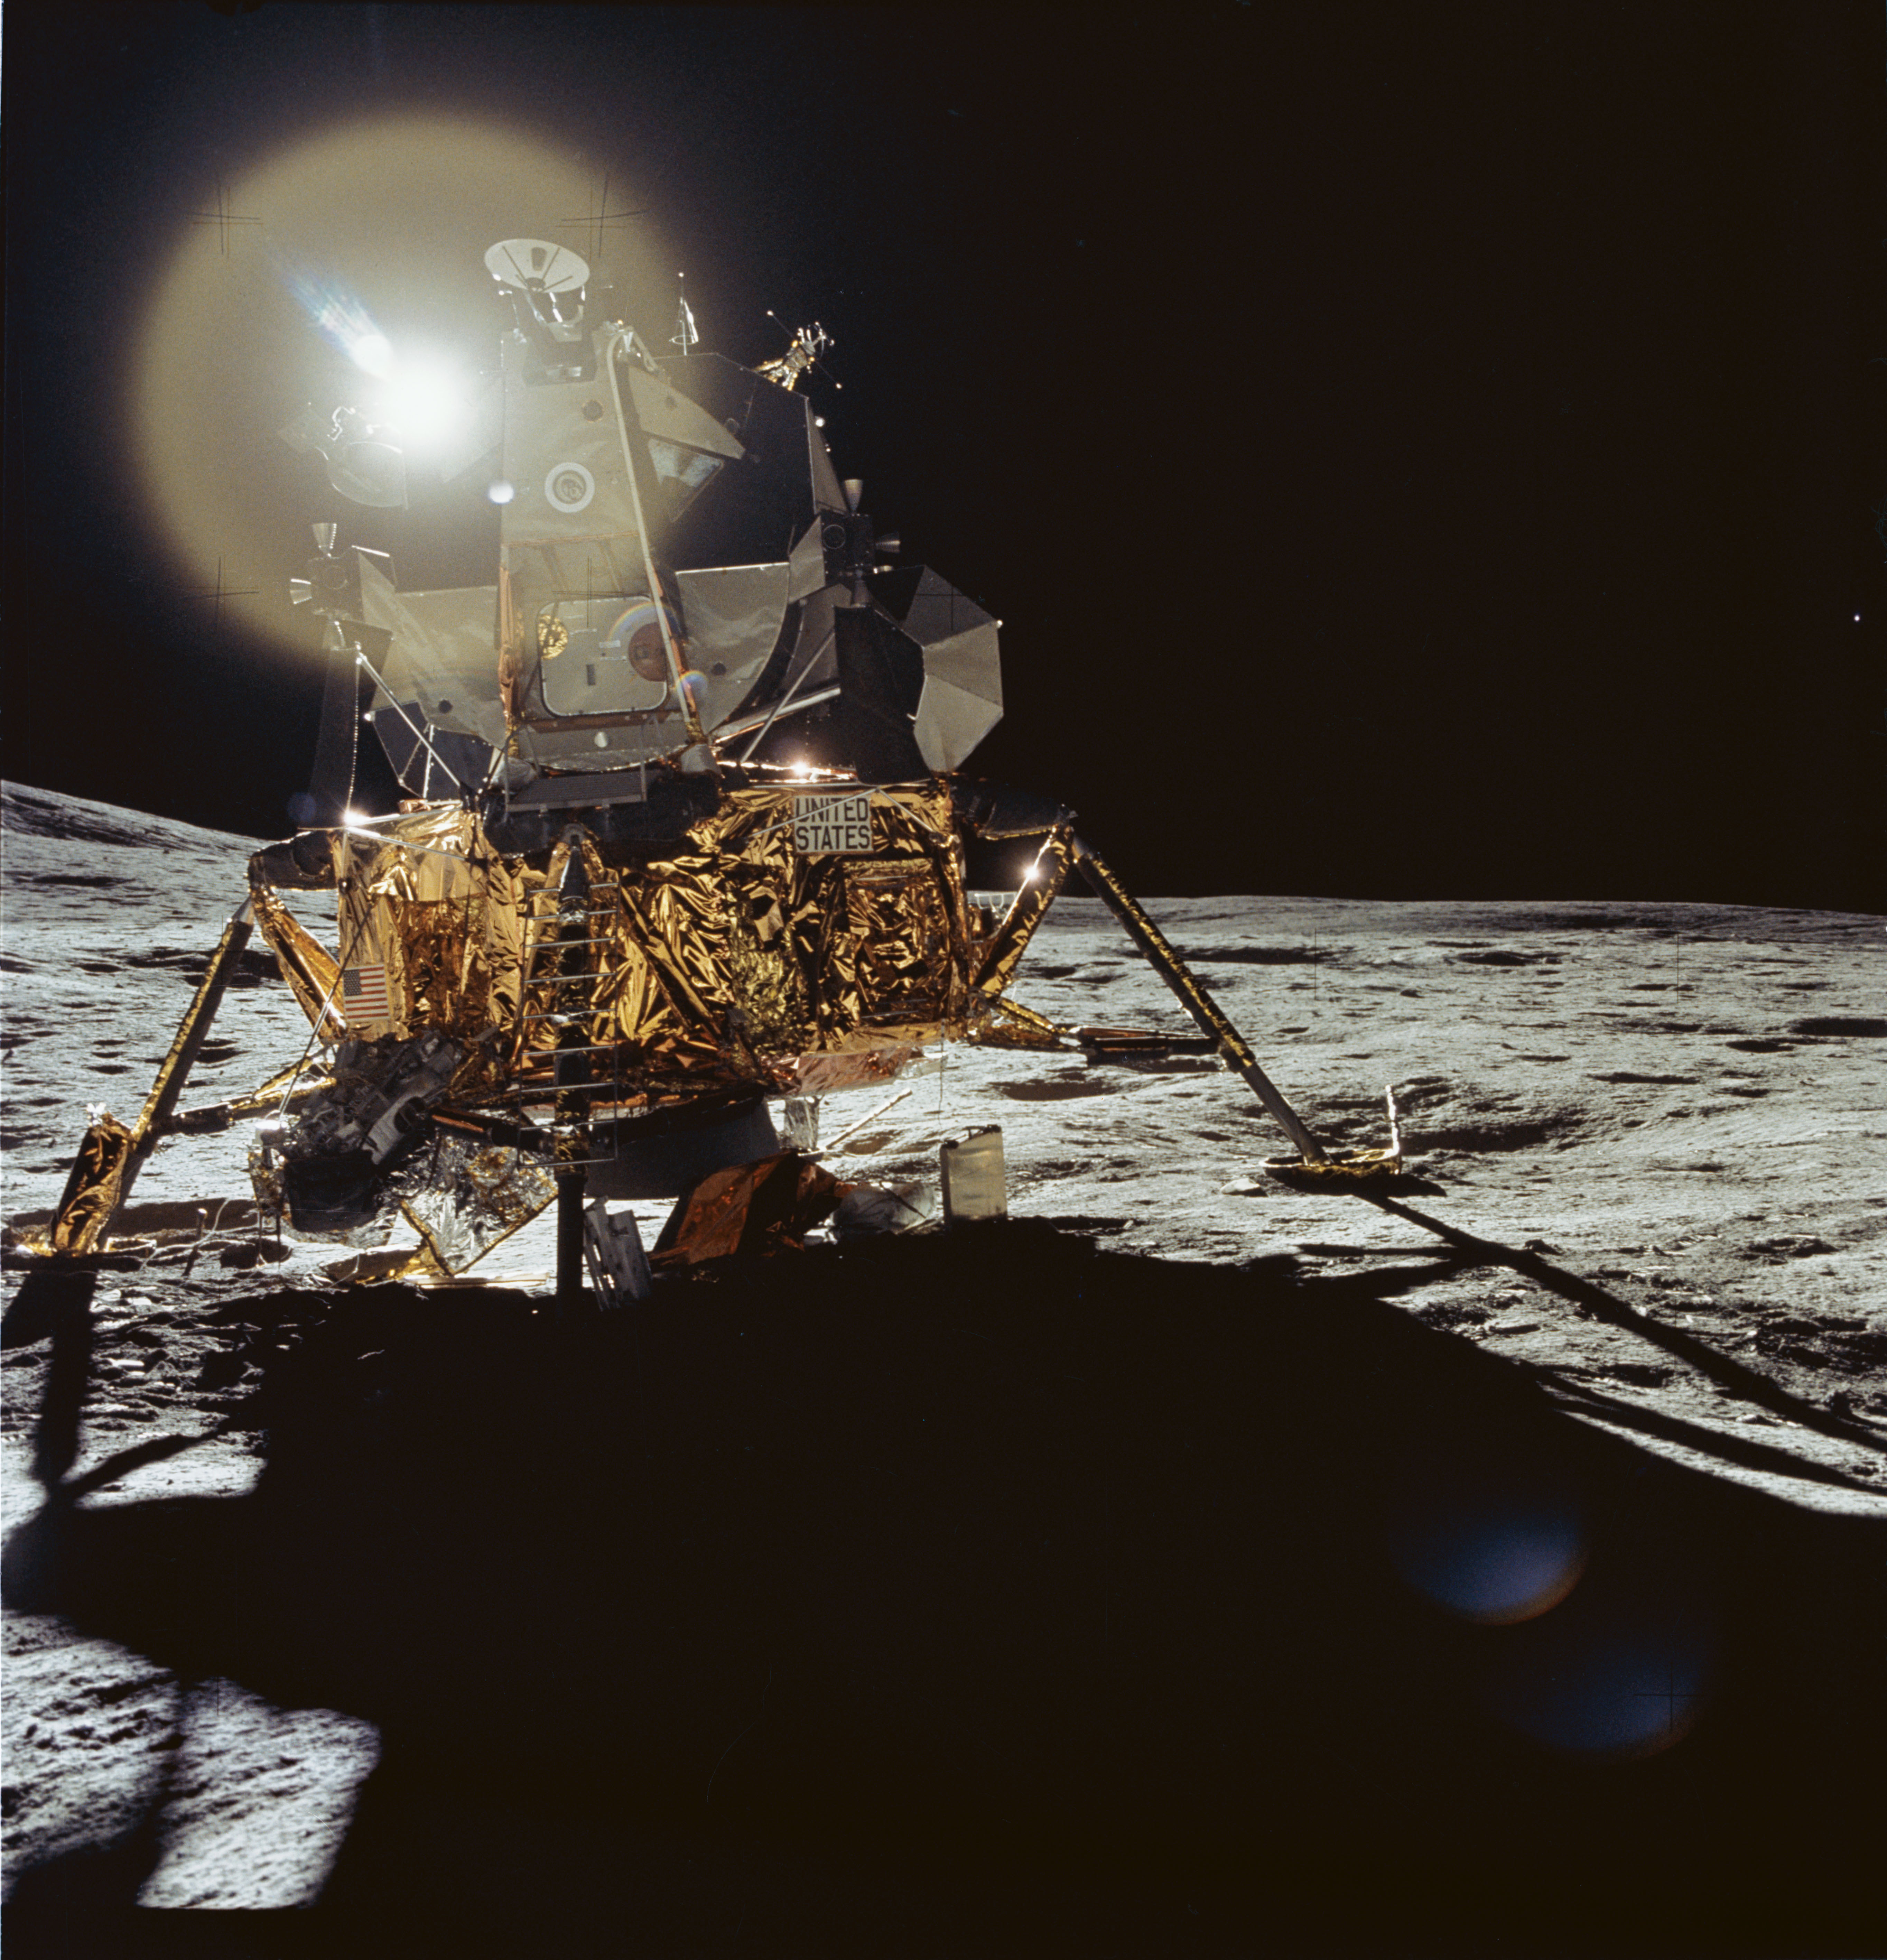

Thank You
View of Apollo 14 Lunar Module on the Moon

Slide 20
References
[1] Rodgers, W. F. (1972). Apollo Experience Report – Lunar Module Landing Gear Subsystem (NASA TN 0-6850). Washington , D.C. : National Aeronautics and Space Administration.
[2] INCO. (1974). Materials for Cryogenic Service: Engineering Properties of Austenitic Stainless Steels. Nickle Development Institute .

Slide 21
Backup Slides

Slide 22
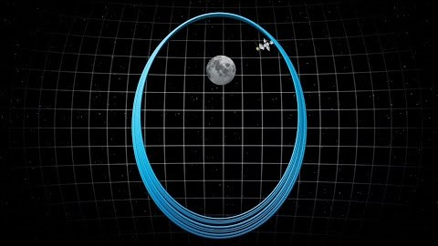

Back Up Project Description

Slide 23
Back Up Functional Decomp
Functional Decomposition Cross Reference Table. Rows more important than columns
 | Withstand Shock | Support Weight | Absorb Impact Energy | Dampen Vibrations | Prevent Excessive Rebound | Transform Energy | Dissipate Energy | Store Energy | Return to Origingal State | Sum
Withstand Shock | - | 1 | 0 | 1 | 1 | 1 | 1 | 1 | 1 | 7
Support Weight | 0 | - | 0 | 1 | 1 | 1 | 1 | 1 | 1 | 6
Absorb Impact Energy | 1 | 1 | - | 1 | 1 | 1 | 1 | 1 | 1 | 8
Dampen Vibrations | 0 | 0 | 0 | - | 0 | 0 | 1 | 1 | 0 | 2
Prevent Excessive Rebound | 0 | 0 | 0 | 1 | - | 1 | 1 | 1 | 0 | 4
Transform Energy | 0 | 0 | 0 | 1 | 0 | - | 1 | 1 | 0 | 3
Dissipate Energy | 0 | 0 | 0 | 0 | 0 | 0 | - | 1 | 0 | 1
Store Energy | 0 | 0 | 0 | 0 | 0 | 0 | 0 | - | 0 | 0
Return to Origingal State | 0 | 0 | 0 | 1 | 1 | 1 | 1 | 1 | - | 5
Rank | 2 | 3 | 1 | 7 | 5 | 6 | 8 | 9 | 4
Rank | Function
1 | Absorb Impact Energy
2 | Withstand Shock
3 | Support Weight
4 | Return to Original State
5 | Prevent Excessive Rebound
6 | Transform Energy
7 | Dampen Vibrations
8 | Dissipate Energy
9 | Store Energy

Slide 24
Back Up Concept Selection: HoQ
 | Importance rating | Absorb Impact Energy | Absorb Structural Shock | Support Mass | Return to Original State | Indicate Reusability | Prevent Excessive Rebound | Transform Energy | Dampen Vibrations | Dissipate Energy | Store Energy | Withstand Lunar Conditions
The product can be used indefinitely. | 3 | 3 | 2 | 2 | 3 | 2 |  | 1 | 1 | 1 | 1 | 3
The product is lightweight. | 3
The product can be sent to the moon and used repeatedly. | 3 | 3 |  | 1 | 3 | 2 |  |  |  |  |  | 3
No routine maintenance is necessary during remainder of each lunar trip. | 1 |  |  |  | 2 | 1
Shock absorber dynamic qualities does not change or diminish after an impact. | 2 | 2 | 2 | 1 | 1 |  | 1 | 1 |  | 1 | 1
The product can handle an impact speed of 10 feet per second. | 3 | 3 | 3
The product can support 25,000 kg. | 2 |  | 3 | 3 |  |  | 2
The product can land at up to a 10-degree offset from the z-axis. | 1 |  |  |  |  |  | 1
Raw Score (total) | 146 | 31 | 21 | 17 | 21 | 13 | 7 | 5 | 3 | 5 | 5 | 18
Relative weight (%) | 100 | 21.23 | 14.38 | 11.64 | 14.38 | 8.90 | 4.79 | 3.42 | 2.05 | 3.42 | 3.42 | 12.33
Rank Order |  | 1 | 2 | 5 | 3 | 6 | 7 | 8 | 11 | 9 | 10 | 4

Slide 25

Back Up Concept Selection: Pugh 1
 |  | Concept
Selection Criteria | Datum | 1 | 2 | 3 | 4 | 5 | 6 | 7 | 8
Absorb Impact Energy | Apollo Shock Absorbers | - | s | + | + | + | s | + | s
Absorb Structural Shock |  | - | + | - | + | + | - | s | s
Support Mass |  | s | s | - | S | s | s | s | s
Return to Original State |  | + | + | + | + | + | + | + | +
Indicate Reusability |  | + | + | + | - | - | + | s | -
Prevent Excessive Rebound |  | - | - | + | + | + | + | + | +
Transform Energy |  | S | + | s | s | s | + | + | s
Dampen Vibrations |  | + | + | + | + | + | - | + | +
Dissipate Energy |  | s | + | s | s | s | + | s | s
Store Energy |  | s | s | s | + | s | + | + | s
Withstand Lunar Conditions |  | - | + | - | - | - | - | s | +
#of pluses |  | 3 | 6 | 5 | 6 | 5 | 6 | 6 | 3
# of minuses |  | 4 | 1 | 3 | 1 | 1 | 3 | 0 | 1

Slide 26
Back Up Concept Selection: Pugh 2
 | Concepts
Selection Criteria | Datum | 2 | 7 | 4
Absorb Impact Energy | Spider Legs | + | + | S
Absorb Structural Shock |  | + | + | +
Support Mass |  | s | + | -
Return to Original State |  | + | + | S
Indicate Reusability |  | s | - | +
Prevent Excessive Rebound |  | - | + | +
Transform Energy |  | + | + | +
Dampen Vibrations |  | - | + | +
Dissipate Energy |  | s | + | S
Store Energy |  | + | + | S
Withstand Lunar Conditions |  | s | + | -
#of pluses |  | 5 | 10 | 5
# of minuses |  | 2 | 1 | 2

Slide 27
Back Up Concept Selection: AHP 1
Criteria Matrix [c]
Customer Needs | Lightweight | Reusable | Dynamic qualities do not change after impact "hopping" | Reduce to <3Gs acceleration | Consistent tooling | handle impact 10ft/s | can support 25000kg | <10 degree offset from z axis
Lightweight | 1.00 | 0.33 | 0.33 | 0.20 | 3.00 | 0.14 | 0.20 | 0.33
Reusable | 3.00 | 1.00 | 3.00 | 0.33 | 5.00 | 0.20 | 0.33 | 3.00
Dynamic qualities do not change after impact | 3.00 | 0.33 | 1.00 | 0.20 | 3.00 | 0.20 | 0.20 | 0.33
Reduce to <3Gs acceleration | 5.00 | 3.00 | 5.00 | 1.00 | 5.00 | 0.33 | 0.33 | 3.00
Consistent tooling | 0.33 | 0.20 | 0.33 | 0.20 | 1.00 | 0.33 | 0.33 | 0.33
handle impact speed 10ft/s | 7.00 | 5.00 | 5.00 | 3.00 | 3.00 | 1.00 | 3.00 | 5.00
can support 32800kg | 5.00 | 3.00 | 5.00 | 3.00 | 3.00 | 0.33 | 1.00 | 5.00
<10 degree offset from z axis | 3.00 | 0.33 | 3.00 | 0.33 | 3.00 | 0.20 | 0.20 | 1.00
Sum | 27.33 | 13.20 | 22.67 | 8.27 | 26.00 | 2.74 | 5.60 | 18.00

Slide 28
Back Up Concept Selection: AHP 2
Normalized Matrix |  |  |  |  |  |  |  |  | {W}
Lightweight | 0.04 | 0.03 | 0.01 | 0.02 | 0.12 | 0.05 | 0.04 | 0.02 | 0.0403
Reusable | 0.1098 | 0.0758 | 0.1324 | 0.0403 | 0.1923 | 0.0729 | 0.0595 | 0.1667 | 0.1062
Dynamic qualities do not change after impact | 0.1098 | 0.0253 | 0.0441 | 0.0242 | 0.1154 | 0.0729 | 0.0357 | 0.0185 | 0.0557
Reduce to <3Gs acceleration | 0.1829 | 0.2273 | 0.2206 | 0.1210 | 0.1923 | 0.1215 | 0.0595 | 0.1667 | 0.1615
Consistent tooling | 0.0122 | 0.0152 | 0.0147 | 0.0242 | 0.0385 | 0.1215 | 0.0595 | 0.0185 | 0.0380
handle impact speed 10ft/s | 0.2561 | 0.3788 | 0.2206 | 0.3629 | 0.1154 | 0.3646 | 0.5357 | 0.2778 | 0.3140
can support 32800kg | 0.1829 | 0.2273 | 0.2206 | 0.3629 | 0.1154 | 0.1215 | 0.1786 | 0.2778 | 0.2109
<10 degree offset from z axis | 0.1098 | 0.0253 | 0.1324 | 0.0403 | 0.1154 | 0.0729 | 0.0357 | 0.0556 | 0.0734
Sum | 1 | 1 | 1 | 1 | 1 | 1 | 1 | 1 | 1.0000

Slide 29
Back Up Concept Selection: AHP 3
Weighted Sum Vector {Ws} | {W} | {Cons}
0.352 | 0.0403 | 8.737873 |  | n | 8
0.992 | 0.1062 | 9.337189 |  | lambda | 9.181082
0.488 | 0.0557 | 8.754142 |  | RI | 1.4
1.546 | 0.1615 | 9.571901 |  | CI | 0.168726
0.323 | 0.0380 | 8.492243 |  | CR | 0.120519
3.004 | 0.3140 | 9.567303
2.080 | 0.2109 | 9.863322
0.670 | 0.0734 | 9.124682
 | Average: | 9.181082

Slide 30
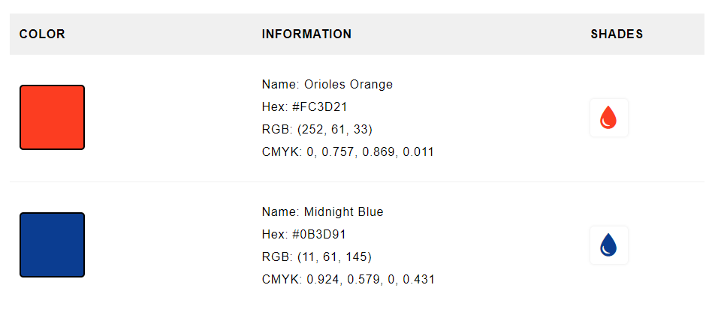
NASA Colors

Slide 31
Progress Trackers

